Slide 1
CSI3120 Lab 4 - Week 6
Presenter: P S Abhiram

Slide 2
Encapsulation
No two classes can directly communicate with each other because then data becomes vulnerable and easy to temper. Just like this Updating, modifying, or deleting data from variables can be done through the use of methods that are defined specifically for the purpose.
The benefit of using this approach to programming is improved control over the input data and better security.
Encapsulation helps to create code that is loosely coupled. Because the details are hidden, it reduces the ability of other objects to directly modify an object’s state and behavior.

Slide 3

Example
Everything you define in this class is restricted to this class only.

Slide 4
Abstraction
Assume you want a function that provides add_2() to its argument. You could probably write something like this:
add_2 <- function(y) { 2 + y }

Slide 5
Contd..
Now suppose you need every other feature that rather provides 7 to its argument.
The herbal issue to do could be to write down any other characteristic, much like add_2, where the 2 is replaced with a 7. But this would be grossly inefficient: if within the future you discover that you made a mistake and also you in truth want to multiply the values instead of adding them, you will be pressured to trade the code in places.

Slide 6
Contd..
In this trivial instance, that won’t be plenty of hassle, but for greater complicated projects, duplicating code is a recipe for catastrophe.
A higher concept could be to put in writing a characteristic that takes one argument, x, that returns every other function which provides its argument, y, to x. In different words, something like this:
add_x <- function(x) {
function(y) { x + y }
}
add_2 <- add_x(2)
add_7 <- add_x(7)

Slide 7
S4 Classes
Compared to S3, the S4 object system is much stricter, and much closer to other OO systems. There are two major differences from S3:
formal class definitions: unlike S3, S4 formally defines the representation and inheritance for each class
multiple dispatch: the generic function can be dispatched to a method based on the class of any number of argument, not just one

Slide 8
Contd..
In S3, you can turn any object into an object of a particular class just by setting the class attribute. S4 is much stricter: you must define the representation of the call using setClass, and the only way to create it is through the constructer function new.
A class has three key properties:
a name: an alpha-numeric string that identifies the class
representation: a list of slots (or attributes), giving their names and classes. For example, a person class might be represented by a character name and a numeric age, as follows: representation(name = "character", age = "numeric")
a character vector of classes that it inherits from, or in S4 terminology, contains. Note that S4 supports multiple inheritance, but this should be used with extreme caution as it makes method lookup extremely complicated.

Slide 9
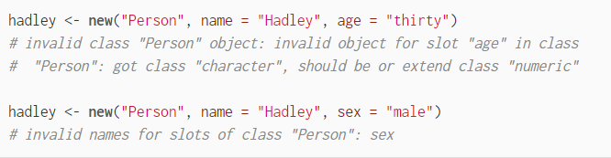
Implementation
You create a class with setClass:
Create S4 class like this:
Create its instance like this:
Be mindful of the way you create the instance:

Slide 10
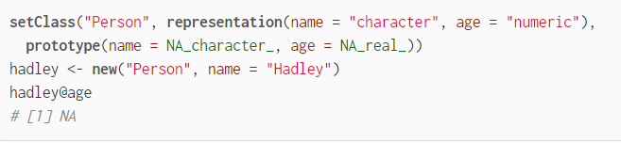
Contd..
Create defaults like this:

Slide 11
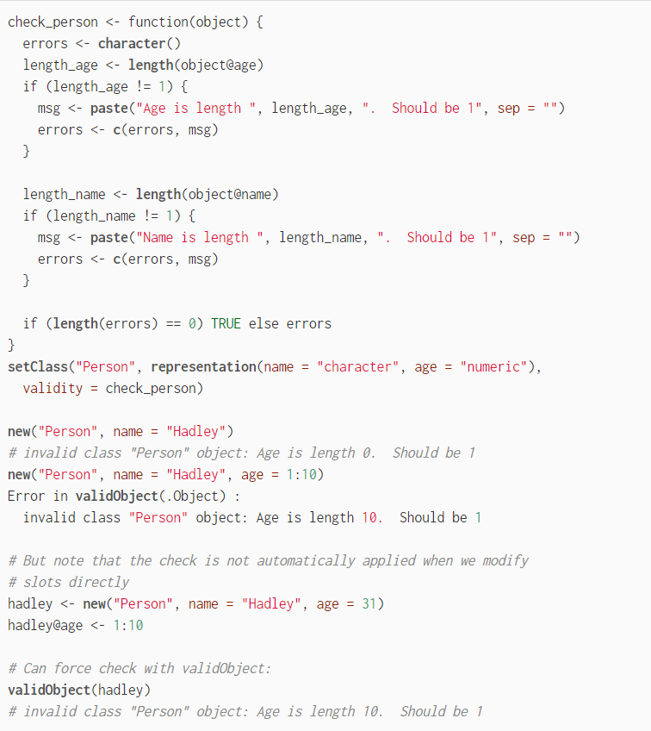
Contd..
Custom check for validity:
check_person checks if the object is correct, but here you write your own custom methods.

Slide 12
Inheritance
Inheritance is an important concept in OOP(object-oriented programming) which allows one class to derive the features and functionalities of another class. This feature facilitates code-reusability.
S3 class in R programming language has no formal and fixed definition.
In an S3 object, a list with its class attribute is set to a class name.
S3 class objects inherit only methods from their base class.

Slide 13
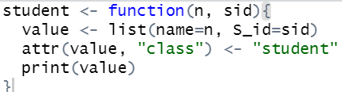
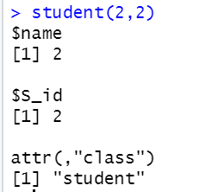
Inheritance Contd..
In the following code, inheritance is done using S3 class, firstly the object is created of the class student.

Slide 14
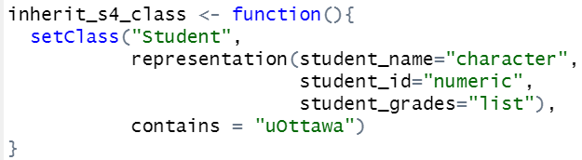
Contd..
In S4:

Slide 15
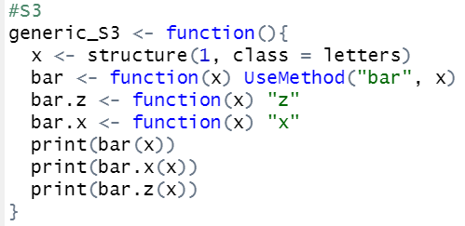
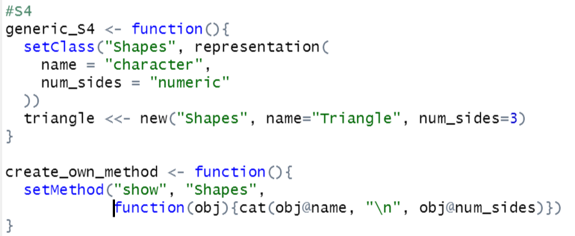
Generic functions and methods
What we did in S3:
In S4, the same idea but stricter.

Slide 16
Custom Example
Create a class Polygon that contains number of sides.
Add a validity functionality to throw error when number of sides is less than or equal to 1.
Define two classes that derive Polygon, namely Triangle and Square which will have the meaningful parameters.
Create two objects for triangle and square.
Create a generic function area.
Overload area such that area is calculated in accordance to the shape.

Slide 17
References
Encapsulation
Abstraction
S3 Classes
S4 Classes
Next week: Concurrency

